Slide 1
avian hazard advisory system (AHAS) training presentation
Current as of 16 Mar 2017

Slide 2
OBJECTIVE
Introduce users to the AHAS system by highlighting specific capabilities, common pitfalls, and best practices
Objective

Slide 3
OVERVIEW
Outputs
  Current Conditions (current hour query)
  Forecast Conditions (>1 and ≤ 24 hrs query)
  Historical Conditions (> 24 hr query)
  Risk Summary
Common Misunderstandings
Best Practices
Innovations
Overview

Slide 4
AHAS
Predicts bird movements within low level flight arena for the contiguous 48 states and Alaska
Found at http://www.usahas.com
Uses filtered NEXRAD data, National Weather Service (NWS) Forecasts, Soaring Bird Forecast Models, and Bird Avoidance Model (BAM) to predict bird movements
Provides CONUS and Alaska bird strike risk for:
  IR, VR, and SR routes
  Ranges and MOA’s
  Some Military and Civilian Airfields
  Alert Areas
AHAS

Slide 5
OUTPUTS
If you request information for:
  Current Hour: risk is based on observations made by the NEXRAD weather radar system, data from the Soaring Model or from the US BAM
  Less Than 24 hrs (>1 and ≤ 24 hrs query): risk is based on the Soaring Model or the US BAM. These models forecast conditions favorable for hazardous bird activity to be present
  More Than 24 hrs, or historical (> 24 hour query or past conditions): risk information comes from the current version of the US BAM
Outputs

Slide 6
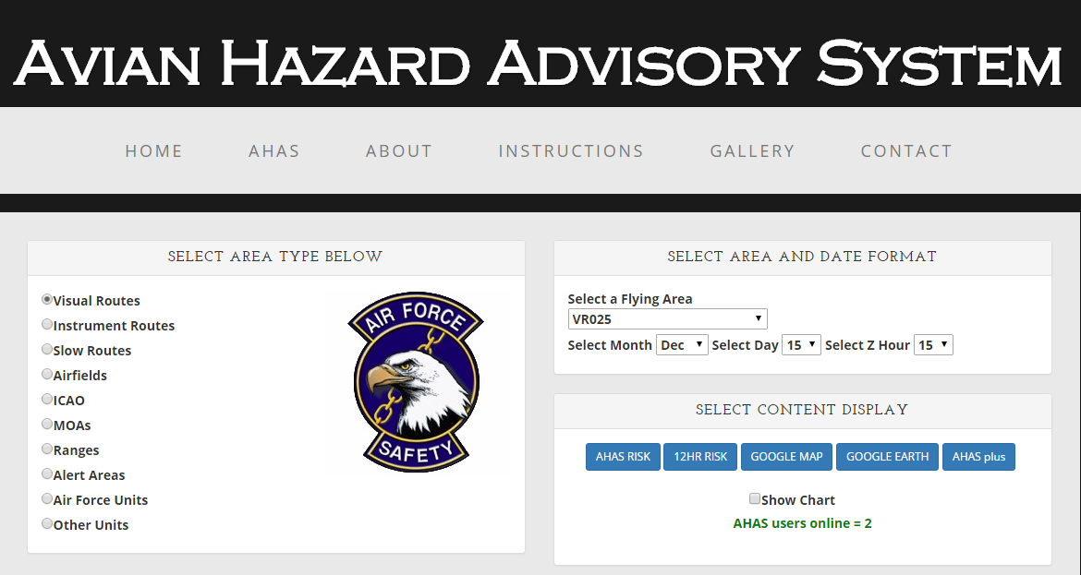
AHAS MAIN QUERY PAGE
AHAS web page tabs
AHAS immediately directs you to the query page. Check for news and other important information using the tabs at the top
AHAS allows you to select airfields based on the ICAO
To request a new unit specific page, contact the USAF BASH Team
You can also select output type
More tabs at bottom
Output selection and chart option
AHAS QUERY

Slide 7
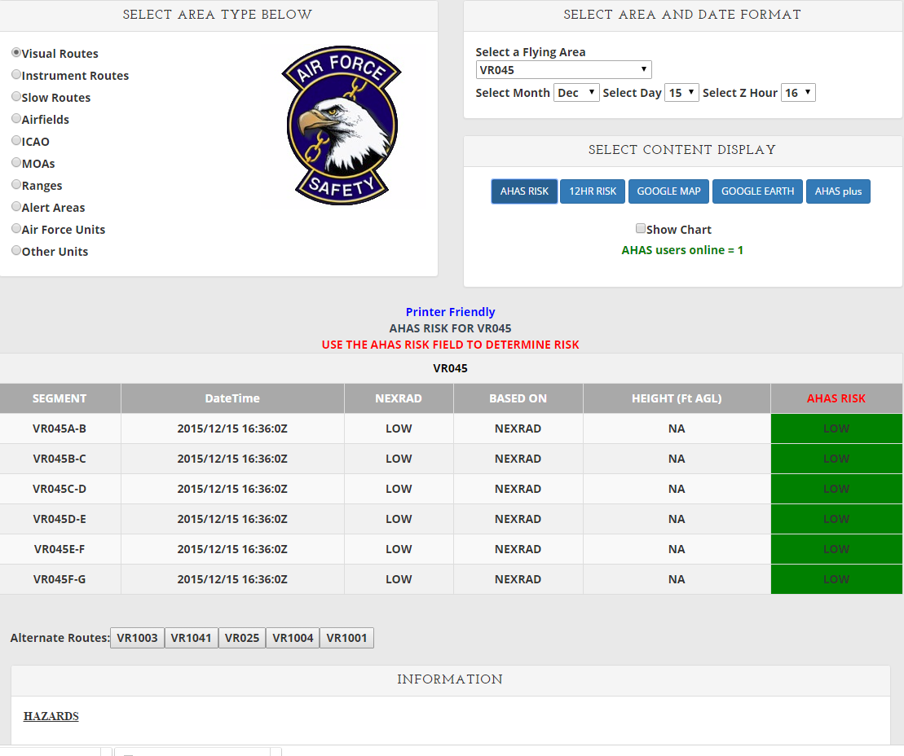
TABLE OUTPUT
1
2
3
Search Criteria: VR 045 (1, 2), current hour in Zulu (3), output choice, AHAS RISK (4)
AHAS indicates the driving model (5) for the overall risk (6), which is color coded based on risk
The results from NEXRAD will always be shown for the current hour(7)
AHAS also shows the nearest five other routes(8)
AHAS shows hazards found along the route, including dams, golf courses, landfills and past bird strikes(9)
The web page updates every 6 minutes when the data is updated in the database.
4
9
8
7
5
6
Output

Slide 8
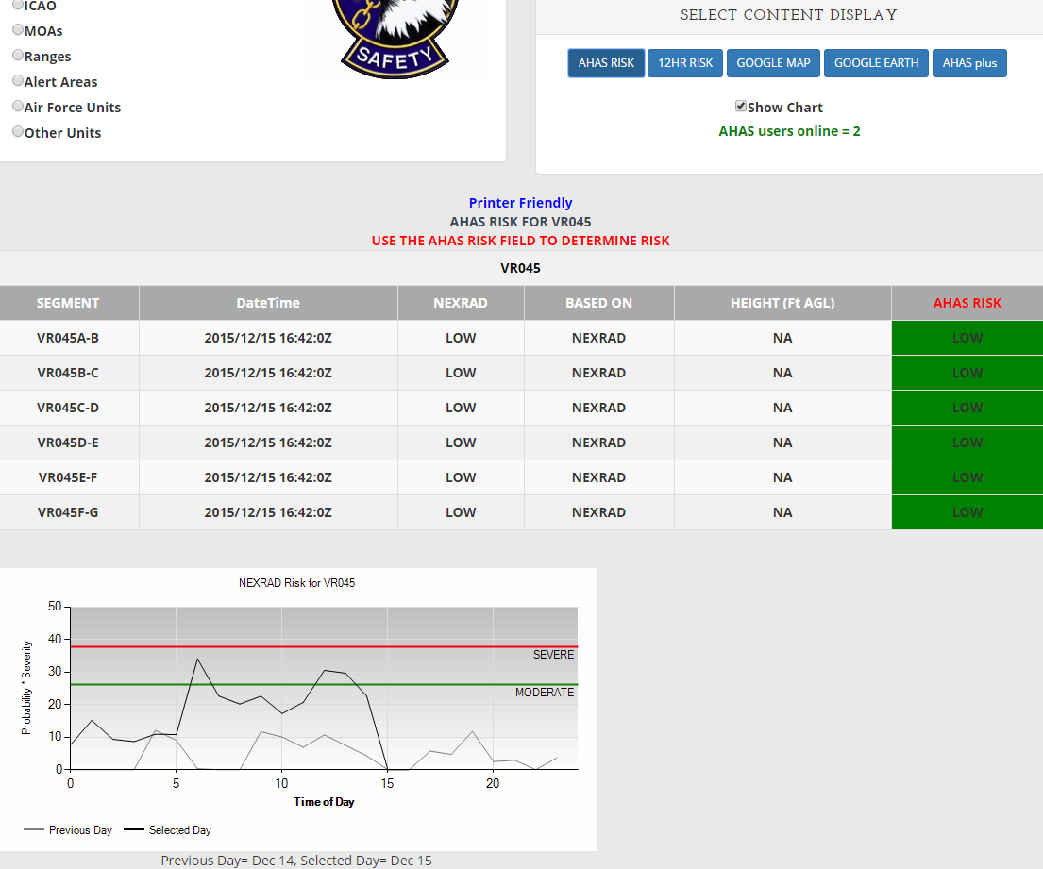
TABLE OUTPUT WITH CHART
Check the show chart box to display the NEXRAD data chart (1,2).
The chart shows the maximum NEXRAD risk for the selected flying area for each hour. Due to the high dynamic range of the radar reflectivity data the chart uses the log10 value of the probability * severity value seen in slide 15, “Calculating NEXRAD Risk”.
The chart shows the risk for the selected day (black line) and the previous day (gray line).
1
2
Output

Slide 9
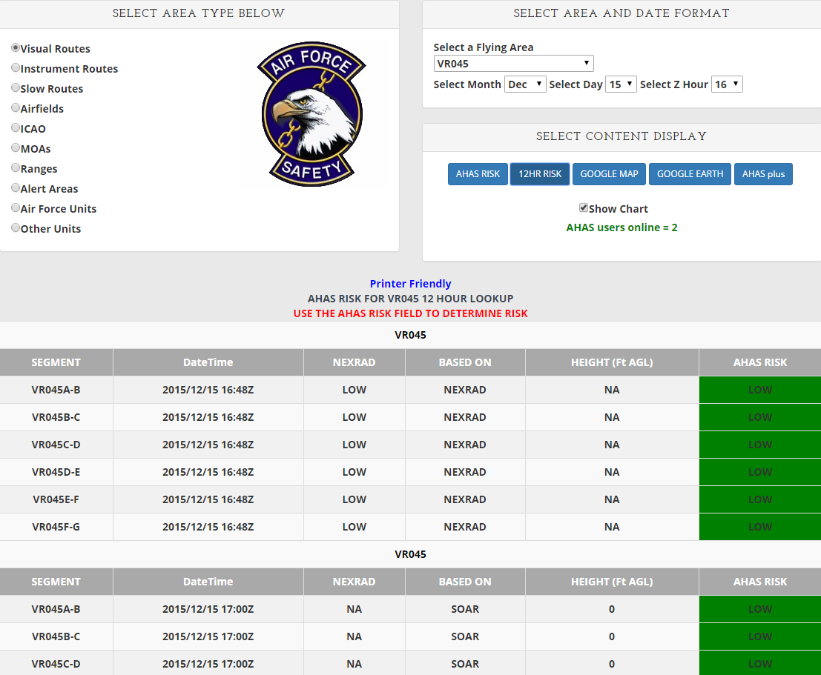
12 HOUR TABLE OUTPUT
Search Criteria: VR 045 (1, 2), hour in Zulu (3), output choice, 12HR RISK (4)
AHAS indicates the driving model (5) for the overall risk (6), color coded
NEXRAD risk is only available for the current hour
12 hours of risk will be shown starting at the selected hour
Scroll down for more hours
No hazards or alternate routes are shown on the 12 hour web page
Expect longer download times for expanded data
1
2
3
4
5
6
Output

Slide 10
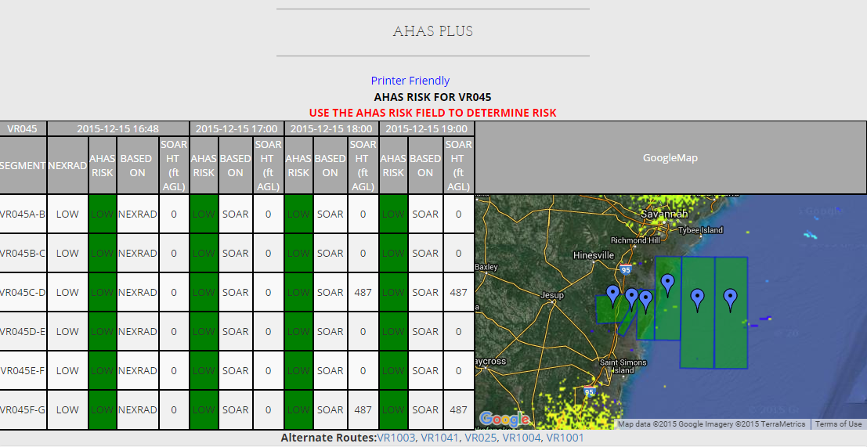
AHAS PLUS
Selected hour information
NEXRAD RISK, AHAS RISK, BASED ON, SOAR HT.
Next 3 hours
AHAS plus table opens in a new window
Hazards and alternate routes will still display (not shown)
Displays selected hour and the next 3 hours
NEXRAD risk is only available for the current hour
Shows driving model and overall risk (color coded) for all 4 hours
Shows selected area and NEXRAD data in Google Map display
Output

Slide 11
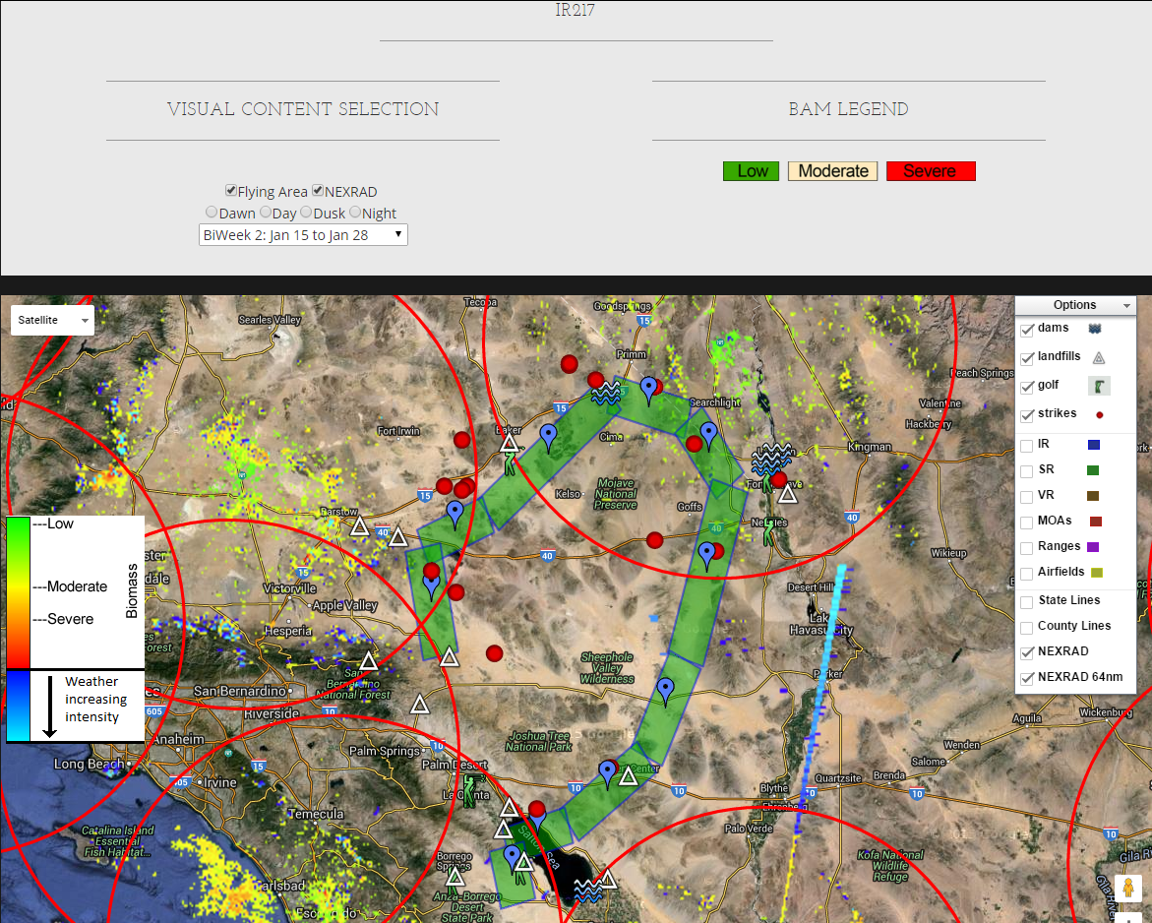
MAP OUTPUT
Search Criteria: IR217, route color based on current risk. Automatically updates every 6 minutes (1).
Google Map is available for unit- specific pages, but they may be very slow depending on the number of areas.
Standard Google Map features include pan, zoom and map view or satellite view(2).
Select different BAM biweeks and periods (3).
May add different map options (4).
3
2
Severe risk
4
Low risk
Moderate risk
1
Output

Slide 12
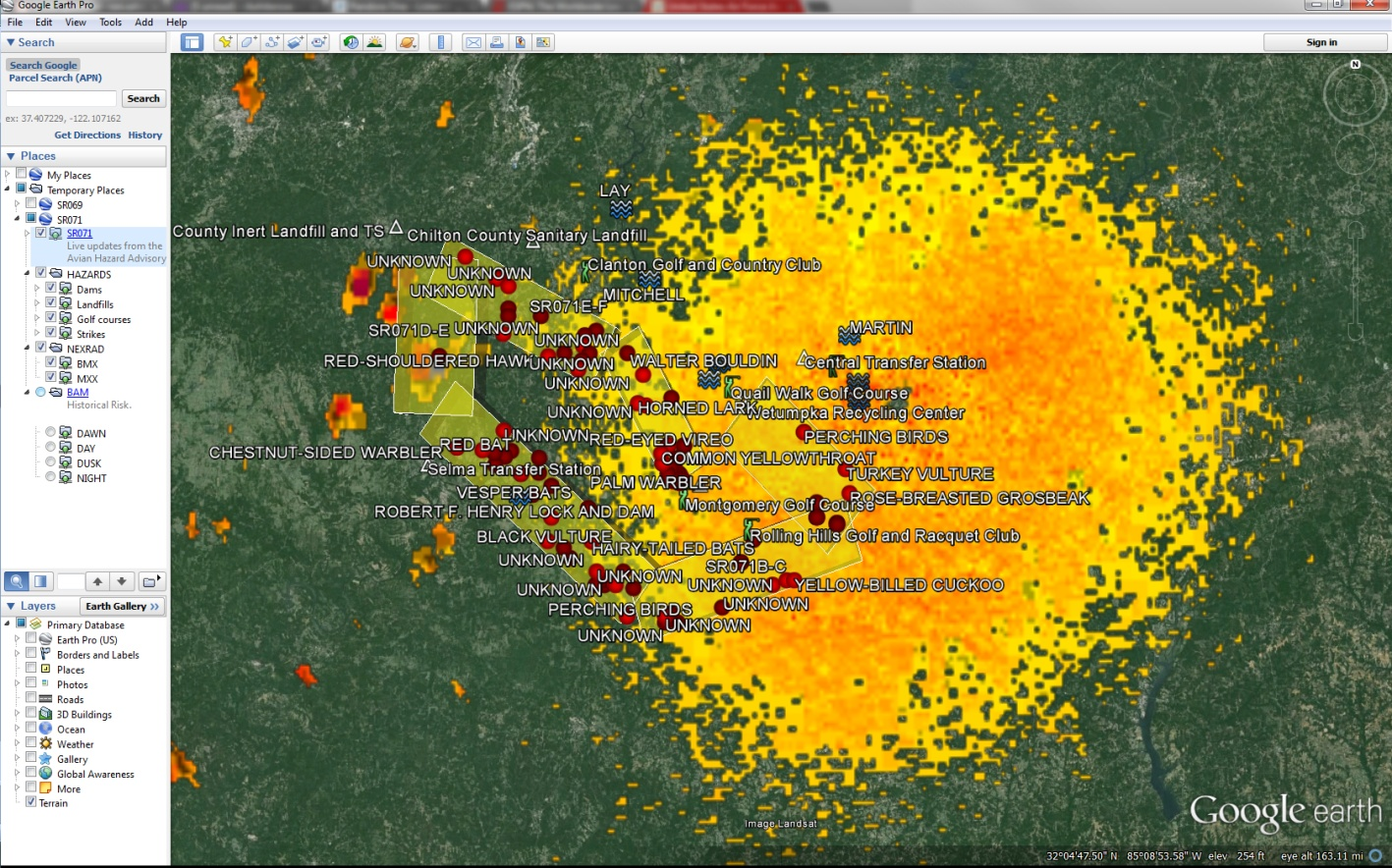
GOOGLE EARTH OUTPUT
(available only on Google Earth enabled computers)
Search Criteria: SR 071, current hour
Risk matches table results and auto updates every 6-10 minutes
Hazards can be turned on or off, ON in this image
BAM layers can be turned on or off, OFF in this image
Route segment color defines warning level
Green = Low
Yellow = Moderate
Red = Severe
Output

Slide 13
RISK DETERMINATION
The AHAS risk is determined based on the highest risk between the soaring model and the NEXRAD risk
If both the NEXRAD risk and the soaring data are not available, the AHAS risk will be based on the BAM
  If the NEXAD risk is missing the risk will be based on the highest risk between the soaring model and the BAM.
  If the soaring data is missing and the NEXRAD risk is LOW, the AHAS risk will be based on the BAM
Missing NEXRAD data will be indicated on the web page as “NO DATA” in the NEXRAD column
Missing soaring data will be indicated on the web page as “NO DATA” in the Height column
Output

Slide 14
CURRENT HOUR QUERY
Current Condition Query
  Uses NEXRAD weather radar system (updated every 6-10 minutes) to monitor large-scale migratory bird activity in the CONUS and Alaska
  Includes risk from soaring bird activity
  Risk displayed defaults to the most severe prediction model (NEXRAD or Soaring)
    Displayed thermal depth height offers maximum altitude and below where conditions are optimal for hazardous soaring birds to be present
    May use BAM data if either the NEXRAD or soaring risk is missing
  “Based On” field indicates primary source of risk
Queries

Slide 15
CURRENT HOUR - NEXRAD
Operational Risk Management (ORM)
AHAS uses two factors to calculate NEXRAD risk: “Severity” is based on the dBZ (decibels of Z, where Z represents the energy reflected back to the radar) and “Probability” of a bird strike (percentage of area polygon filled with biological activity)
AHAS calculates NEXRAD risk by multiplying Severity and Probability to get a value in the below table (Green = Low, Yellow = Moderate, and Red = Severe)
Any value <= 300 is low risk and > 4000 is severe risk
 | Probability
Severity(z) | 20 | 40 | 60 | 80 | 100
3 | 60 | 120 | 180 | 240 | 300
10 | 200 | 400 | 600 | 800 | 1000
30 | 600 | 1200 | 1800 | 2400 | 3000
100 | 2000 | 4000 | 6000 | 8000 | 10000
300 | 6000 | 12000 | 18000 | 24000 | 30000
Queries

Slide 16
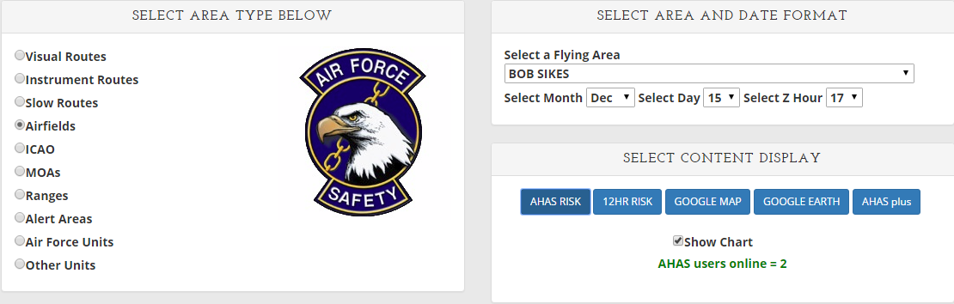
CURRENT HOUR QUERY
2
3
1
4
Query Example – Bob Sikes
  Go to www.usahas.com
  Click desired area (1, Airfields)
  Select Bob Sikes(2), current hour in Zulu (3), and output format (4)
  Note: Airfield Category predicts conditions above and in a 5 nautical mile radius around the airfields and not on the fields themselves
  Actual airfield conditions should be determined by observed conditions and relayed through BWC
Queries

Slide 17
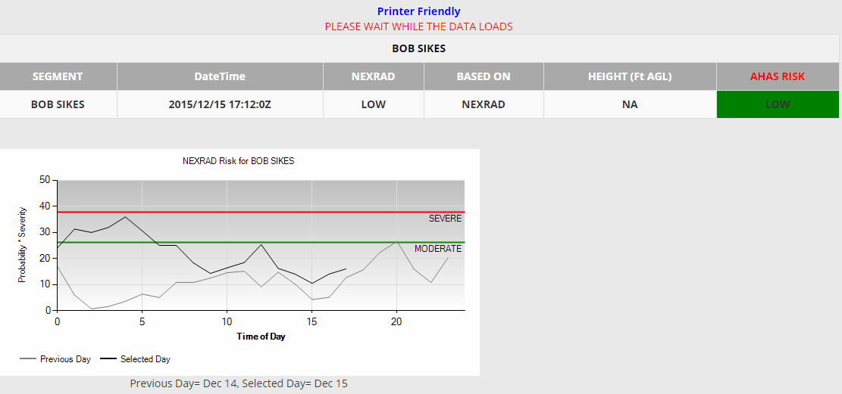
CURRENT HOUR QUERY
NEXRAD column shows the current NEXRAD risk. “NO DATA” indicates that the radar is down or the selected hour is not current
Based On column indicates which model/input is driving the risk reading; in this case, NEXRAD Model
Overall AHAS risk driven by highest risk model. NEXRAD model overrides any ties. Cell is color coded based on risk
Height column shows the max altitude (AGL) where soaring birds might be present. In this case, “NA” indicates that the risk is not based on the soaring model. “NO DATA” indicates that the soaring data is missing
The chart shows the previous days NEXRAD risk compared to today’s risk.
Queries

Slide 18
FORECAST QUERY
(>1 and up to 24 hours)
Forecast Conditions Query
  NWS weather observations and forecast model data predict soaring bird activity in the contiguous 48 states and Alaska
  Soaring models are run twice a day to forecast bird strike risk up to 24 hours in advance
  The Soaring Bird Forecast Model predicts likelihood of soaring birds based on calculating thermal depth and US BAM data
    Displayed thermal depth height indicates where conditions are right for soaring birds to be present
Queries

Slide 19
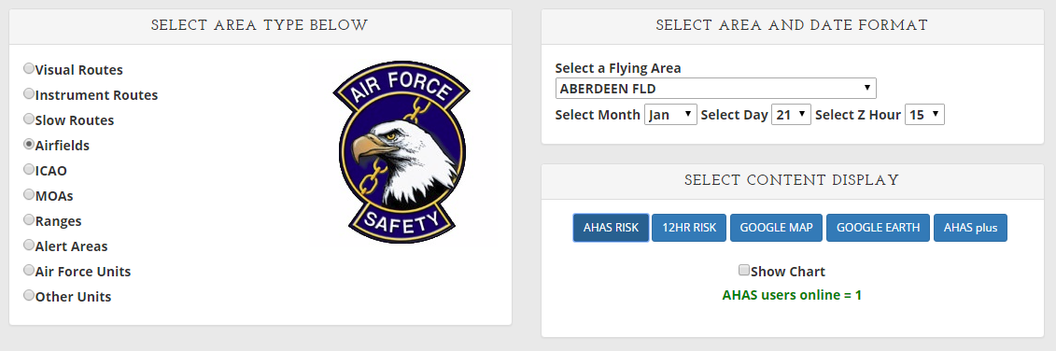
FORECAST QUERY
(>1 and up to 24 hours)
Query Example – Aberdeen Fld
  Go to www.usahas.com
  Click desired area (Airfields)
  Select Aberdeen Fld, desired time, and select output format
  Everything is the same as a current hour query except you select a time between 1 and 24 hrs from current time
Next hour selected
Queries

Slide 20
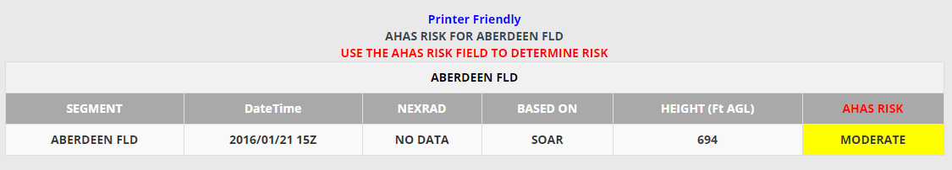
FORECAST QUERY
(>1 and up to 24 hours)
Outside of 1 hour NEXRAD data is not available
Based On column indicates which model/input is driving the risk reading; in this case, SOAR
Query is from between 1 and 24 hours of the current time
Height column shows the max altitude (AGL) where soaring birds might be present. In this case, “694” indicates that conditions are right for soaring birds to be present up to 694’ AGL and below
Queries

Slide 21
HISTORICAL QUERY
(>24 hrs or the past)
AHAS risk prediction reverts to the BAM if:
  Query is for any time prior to the current hour
  Query is for time period >24 hrs in advance of the current hour
  Other data sources are unavailable
Past data can be requested from the USAF BASH Team
Queries

Slide 22
HISTORICAL QUERY
(>24 hrs or the past)
Bird Avoidance Model (BAM) data is based on:
  All bird species present during a particular daily time period, in a particular area, for one of 26 two-week periods in a year
  Geographic information for observations of 60 key BASH species, over a 30-year period
  Several key datasets, including the Audubon Society’s Christmas Bird Count (CBC), the US Biological Survey's Breeding Bird Survey (BBS), bird refuge arrival and departure data for the conterminous US, and data specific to a particular bird species
  Common behavior of species groups modeled for dawn, day, dusk, and night
Queries

Slide 23
RISK SUMMARY
The NEXRAD risk only applies to the current hour. The NEXRAD data shows the bird activity within the last 6 minutes. So that is the most accurate data. There is no way for the NEXRAD data to project what might be happening any time in the future.
NEXRAD data is designed to remove static targets. That's why it doesn't
show mountains and buildings, etc. Soaring birds are static targets when
they are riding thermals. The soaring model was added to cover that
weakness in the NEXRAD data. So even in the current hour, if the soaring risk is higher than the NEXRAD risk, the soaring risk takes precedence.
If the current risk for any area is low based on NEXRAD, that also means that the soaring risk is low. The BAM will only be used in the current hour if the NEXRAD data is missing. If the NEXRAD data is missing, AHAS will use the highest risk between the soaring risk and BAM risk.
For any hour beyond the current hour, the AHAS risk will be based on the highest risk between the soaring model and the BAM.
You cannot look at hours that have passed. When you look a time period that has already passed, you are really looking at that time period next year and all you will get is the BAM risk.
The chart can show the trend of the NEXRAD risk based on the NEXRAD risk from the previous day.
Risk

Slide 24
COMMON MISUNDERSTANDINGS
Misperception: historical data from AHAS contains forecasted or current hour data
  Requested historical data is from the US BAM only
Using AHAS to determine Bird Watch Condition code
  NEXRAD cannot see the lowest airspace\surfaces of the airfield so cannot substitute for on airfield observations of Bird Watch Conditions, it can see the higher altitude movements that are missed at the surface and can add to the bird watch condition, but it cannot evaluate the unseen conditions at the surface
Expecting NEXRAD data for forecasted and historical queries
  NEXRAD is updated every 6-10 minutes for current hour queries only and can not be forecasted or give historical data at this time
Misunderstandings

Slide 25
BEST PRACTICES
Use BAM data when acquiring route times
  Adjust/modify routes based on AHAS forecasts
Use BAM in conjunction with AHAS during planning
  Pinpoint wildlife attractants along route of flight
  Identify NEXRAD coverage areas or nearest radar to route
Access AHAS just prior to step time
Incorporate ops procedures in local BASH plan
  Call SOF/Sqdn Ops to get current AHAS reading prior to base departure, low-level segments, or when approaching airfield/training area
Utilize Unit Specific AHAS Web Pages
Best Practices

Slide 26
BEST PRACTICES
(Unit Web Pages)
Unit Web Pages can include:
  Transition bases
  Flight routes
  Ops and Range Areas
  Specific data impacting mission
Unit Web Pages are ideal for:
  Operations Supervisors
  SOFs
  Crews stepping to fly
Unit Web Pages can be tailored to suit user’s needs
Hazards do not display on unit web pages
Best Practices

Slide 27
INNOVATIONS
GARS
  AHAS risk based on 30 minute polygons across the entire US.
  Selection based on NEXRAD station.
  Only displayed in Google Earth
Weather suppression
  Improved weather suppression.
Inovations

Slide 28
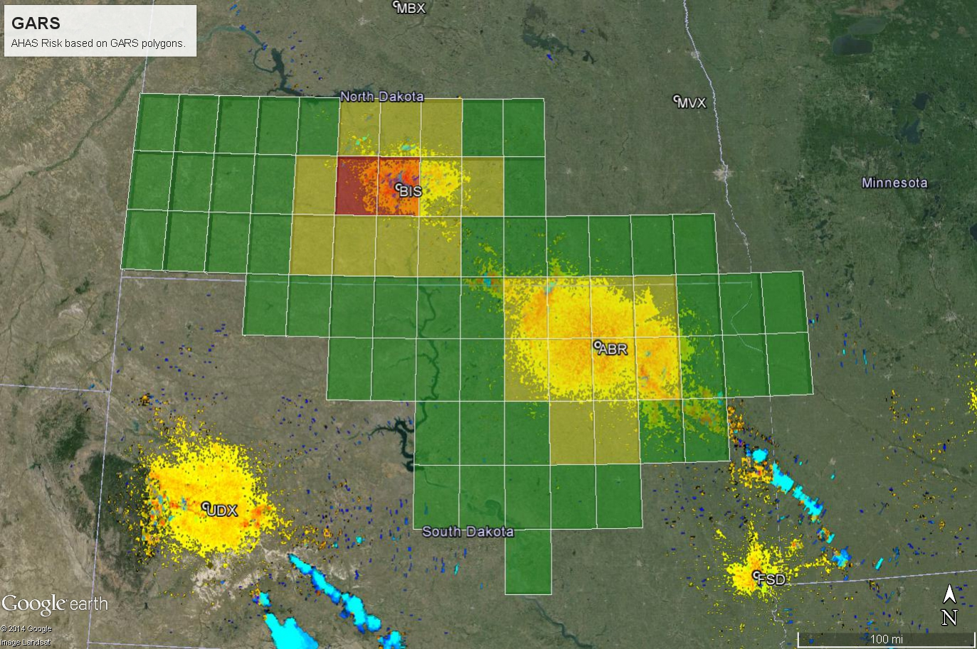
INNOVATIONS
(GARS)
Polygons based on the Global Area Reference System(GARS).
Selections made based on NEXRAD station.
Risk determined using NEXRAD data, soaring data and BAM.
Only useable in Google Earth.
Data auto updates every 6-10 minutes.
Innovations(GARS)

Slide 29
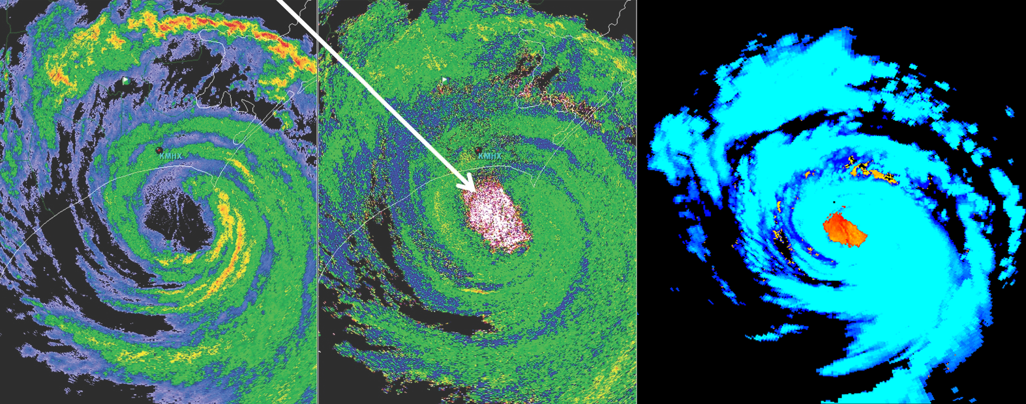
INNOVATIONS
(weather suppression)
Radar analysis from the University of Alabama-Huntsville’s Severe Weather Institute indicates birds trapped in the eye of hurricane Arthur (left two images). Weather suppression software used by DeTect Inc. successfully removes the weather(blue) and retains the birds circled.
Innovations

Slide 30

CONTACT INFORMATION
USAF BASH Team
  Mr. Dan Sullivan, Branch Chief daniel.sullivan.26@us.af.mil, DSN 246-5674
  2d Lt Mary McCullers, Wildlife Ecologist mary.mccullers.1@us.af.mil, DSN 246-5848
  Commercial prefix is (505) 846-xxxx
AHAS Personnel
  Mr. Ron White
  ahas@detect-inc.com
Contact Info

